Slide 1
File Edit Widget and Word Integration
Background
Business Requirements
Current functionality meeting requirements
The Future

Slide 2
File Edit Widget – What is it?
Allows a user to edit a Microsoft Word document on their local computer and then save it to the IBM Cúram database.
Also an additional feature within the Appeals component which allows a clause to picked and automatically inserted into a Word document.
A document can be created automatically from a template where the template details can be set before the document is presented to the user for editing.
The FILE_EDIT widget uses either a Java applet to manage the interaction between the user's browser and Word (for the browsers which support Java e.g. Internet Explorer) or the Native Messaging API for Chrome.
The customers who use this feature like it. Some of these customers are listed below:
  Alberta
  SAMS
  CPIN
  DSCIS
  Hamburg

Slide 3
File Edit Widget – Recent History
Pre version 6.1 of the product, there were many ongoing issues with this feature.
  Performance issues.
  Instabilities when using COM bridge (findWindows).
  Outdated, for one-windowed/popup based application.
  Multiple APARs from customers which proved difficult to reproduce, diagnose and fix due the number of moving parts within the overall feature (browser version, JRE level, Word version etc.).
Chrome then announced they were dropping NPAPI (Java, applet) support.
  http://blog.chromium.org/2014/11/the-final-countdown-for-npapi.html
After some discussion, this led to the building of a “Chrome specific” solution for the feature (included a stand alone Java process and a Chrome extension).
Also led to re-writing of the infrastructure to support the Java widget for Internet Explorer to ensure it was more stable and that the user experience was better.
Overall, 4-5 months of effort to achieve this.
Now have two separate implementations, one for Chrome and one for Internet Explorer.
The Widget has proved relatively stable since it was re-written/re-factored for the 6.1 release.
There are still some customer cases coming in but not of the same volume as pre the re-write.
There are some still edge case issues such as the Word application is left open when the session is terminated unexpectedly.

Slide 4
File Edit Widget – What is Next?
There have been recent announcements from Microsoft that they are going to follow suit and drop the Java plugin support in their browsers in the future.
Oracle have also announced they are going to drop the browser plug-in support starting with the Java 9 release.
These changes have already begun with the Microsoft Edge browser (Windows 10) dropping support for running Java in the browser (applet support).
  http://answers.microsoft.com/en-us/windows/forum/apps_windows_10-msedge/ms-edge-plugins/eb4e3bed-1a0b-4d95-b437-8fdbb4482691
This change in third party policy by Microsoft means that the current file edit solution will not work on Microsoft Edge (we have ran a quick test and found this to be the case).
In addition to that, Microsoft have not yet proposed any alternative to the old functionality and at this stage, Edge is a complete black box with no allowed interaction.
Currently therefore, we could not, even if we wanted, build a bespoke alternative solution for Edge in a similar fashion to Chrome.
What are the alternatives?
  Drop support for this feature altogether from the product.
  Continue support for the feature in Chrome/IE and just state it will not work in Microsoft Edge.
  Provide an alternative solution to solve the customer’s business use case.
  Download/Upload Word Document using existing widgets.
  Investigate open source alternatives?
Further investment in this feature v the benefits. Discuss?

Slide 5
Support Matrix for File Edit Widget
There are a number of variables to be considered in a support matrix for this feature:
  Cúram version.
  Browser Type and Version.
  JRE Version.
  Two current solutions:
    Java applet and the COM bridge combination for the browsers which support applets (IE)
    Native Messaging Bridge (Chrome Extension + Standalone Java Client) + Modified COM bridge for Chrome.
Some significant events (some past and future) also have to be fed into the support matrix:
  Chrome browser discontinue support for running Java in the browser (Sep, 2015).
  Announcements from Microsoft that they are going to follow suit and drop the Java plugin support in future. Latest browser from Microsoft (Edge) already does this.
  JRE 9.0 – Oracle announce that this version will drop browser plug in support (Sep, 2016).

Slide 6
Support Matrix for File Edit Widget (contd.)
Web Browser | V Pre-6.1 |  | V6.1+ | V7 (JRE 7 & 8) | V7 (JRE 9)
 | Pre Sep-2015 | Post Sep-2015
Chrome | Applet | Applet (pre Chrome 45) Not Supported (Chrome 45 and higher versions) | Applet (pre Chrome 45) Bridge/Extension (Chrome 45 and higher versions) | Applet (pre Chrome 45) Bridge/Extension (Chrome 45 and higher versions) | Not Supported (pre Chrome 45) Bridge/Extension (Chrome 45 and higher versions)
IE | Applet | Applet | Applet | Applet | Not Supported
Edge | N/A | N/A | N/A | Not Supported | Not Supported

Slide 7
152269: As a caseworker, I need to be able to open, view and edit MS Word communications from Cúram Communications pages
Business Requirements
152268: As a caseworker, I need the option to select an MS Word Document based on a template that I can edit
152275: As an Appeals user, I need to be able to search for pre-configured text that I can insert into a new MS Word template
152276: As an Administrator, I need to be able to create standard paragraph text (clauses) that can be used to insert into an MS Word template

Slide 8
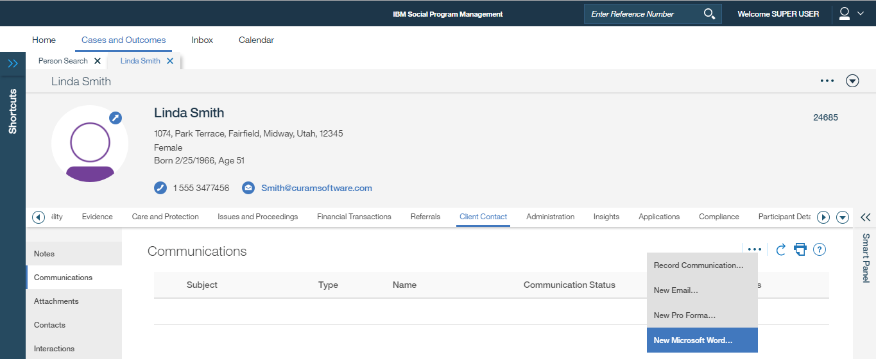
152269: As a caseworker, I need to be able to open, view and edit MS Word communications from Cúram Communications pages
How Business Requirements satisfied today, 7.0.1 screenshots, Chrome Browser
152268: As a caseworker, I need the option to select an MS Word Document based on a template that I can edit
Use Case 1: Person, New Microsoft Word Communication
Person Page -> Client Contact -> Communications -> New Microsoft Word…

Slide 9
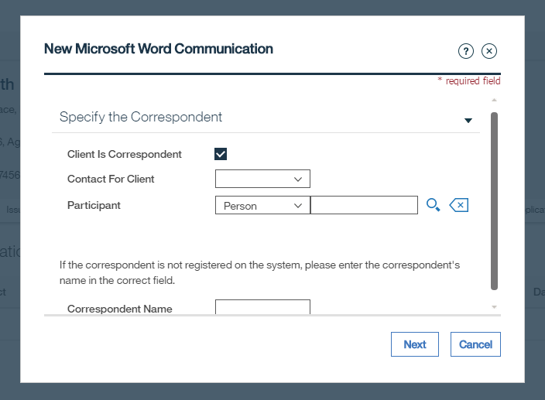
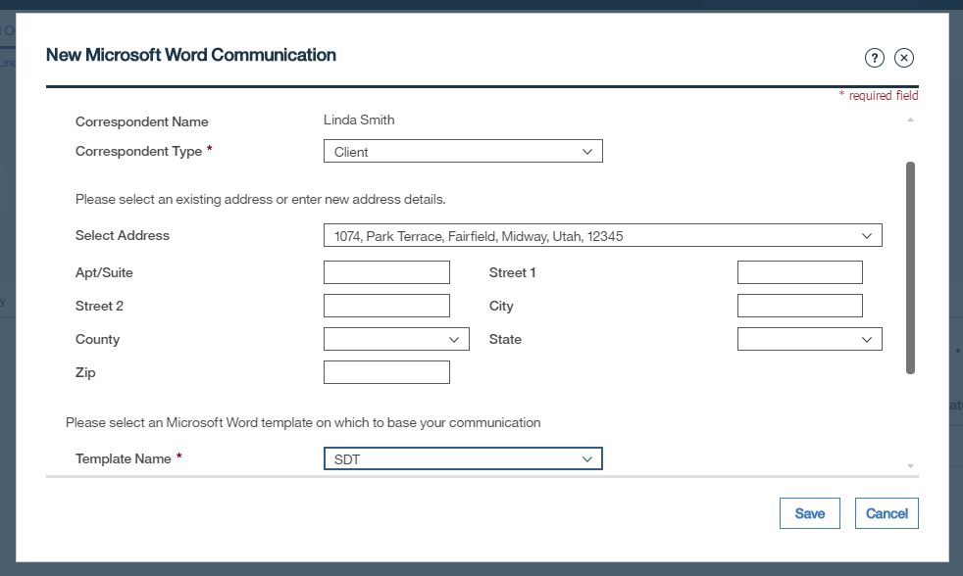
New Microsoft Word Communication Modals
Next ->
Note selection of Template meets requirement 152268
Save ->

Slide 10
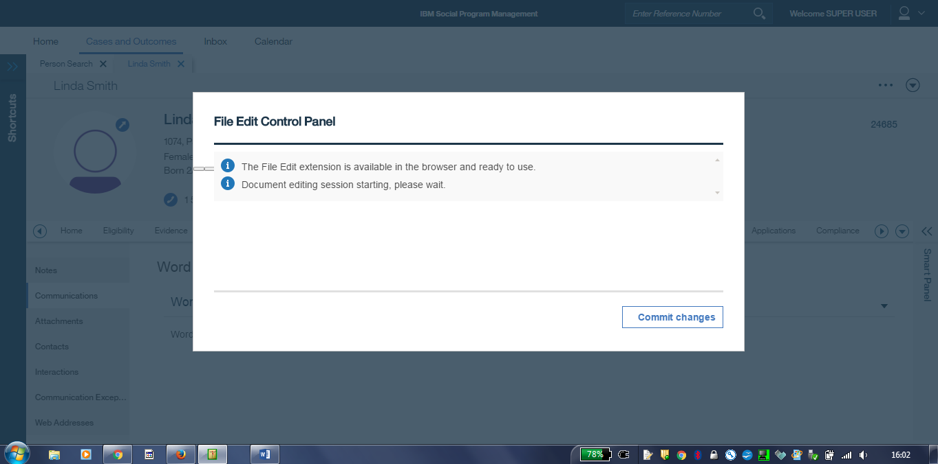
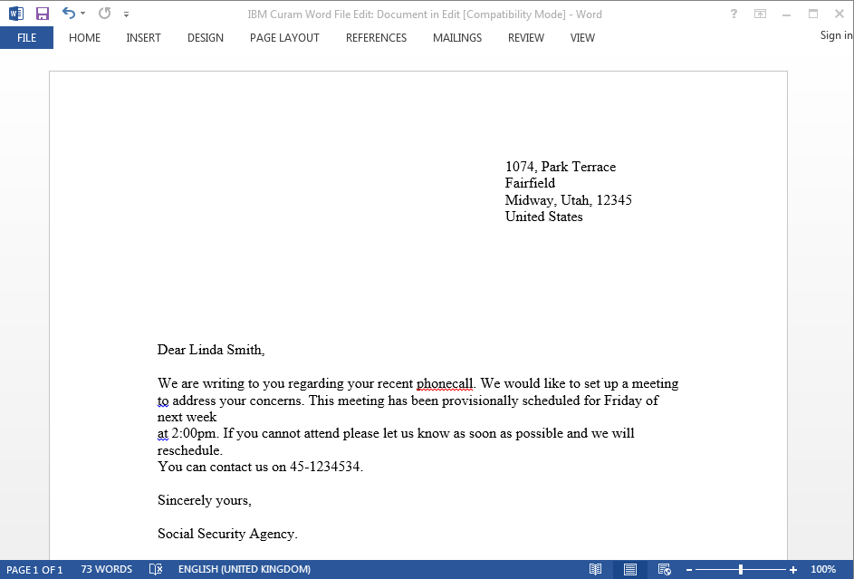
File Edit Control Panel and MS Word Open

Slide 11
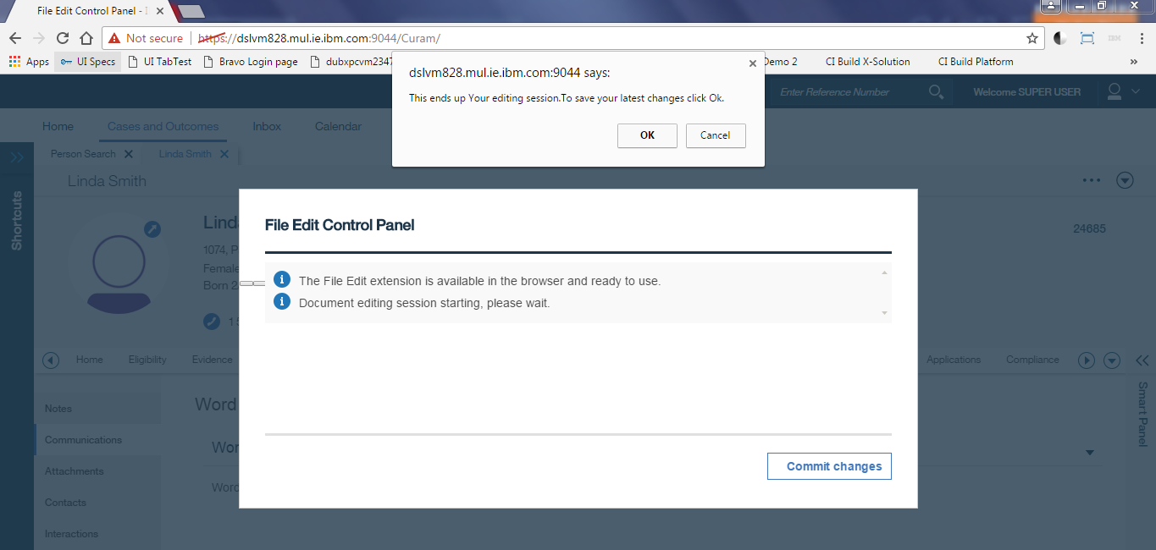
Edit and Close without saving in MS Word
OK ->

Slide 12
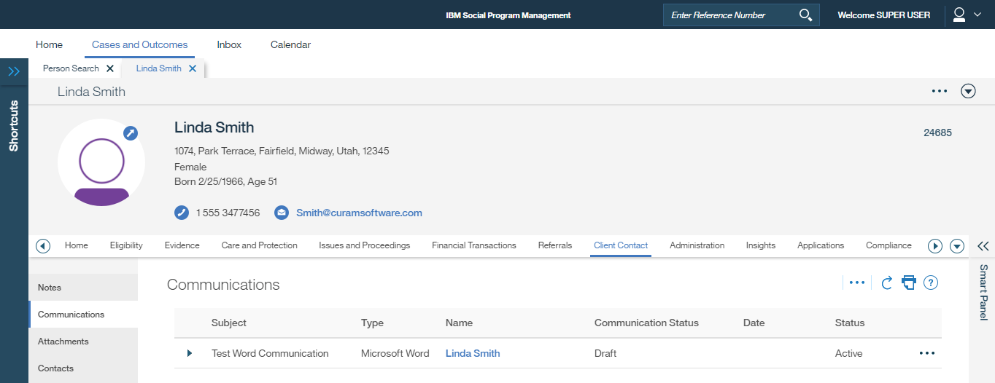
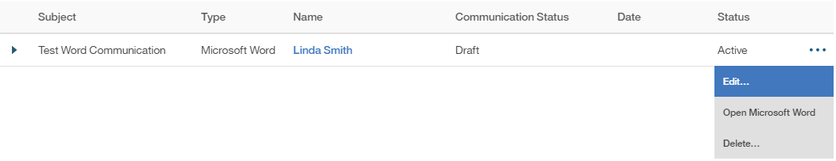
Recorded in Communications List
Edit… ->
View, Edit and Delete options available

Slide 13
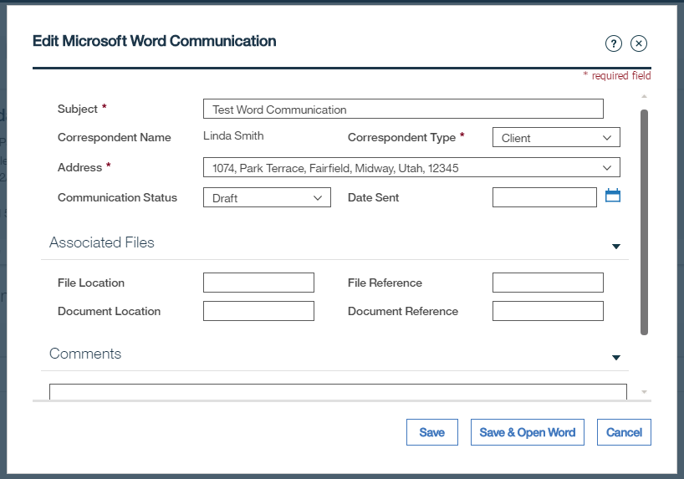
Edit Microsoft Word Communication
Edit details -> Save -> Goes back to Communications List
Edit details -> Save & Open Word -> Opens MS Word

Slide 14
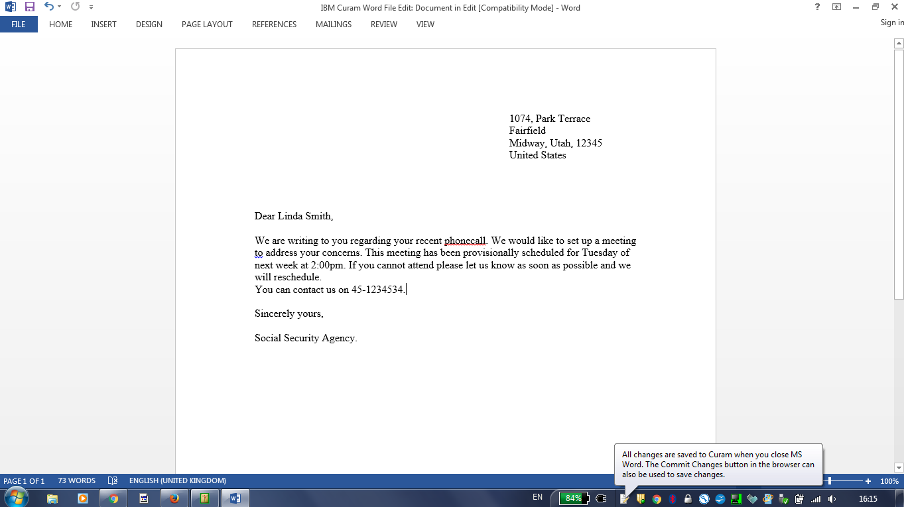
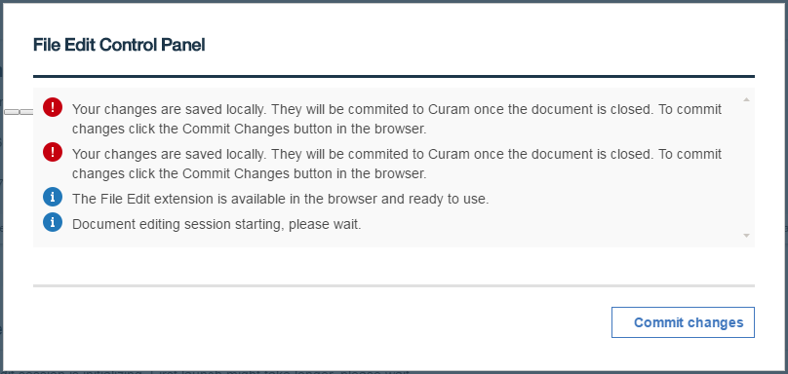
Edit then save in MS Word
Note the taskbar IBM Curam Word Integration Assistant message
… Also reflected in the File Edit Control Panel:

Slide 15
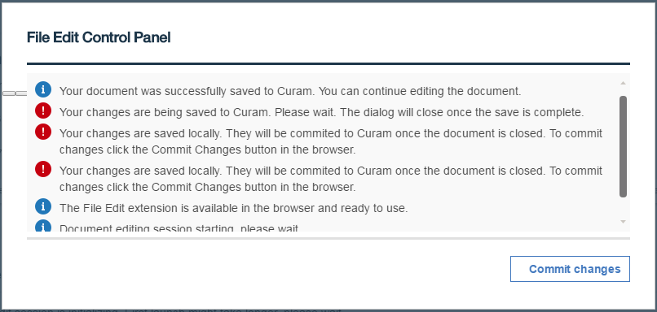
File Edit Control Panel -> Commit changes (while MS Word open)

Slide 16
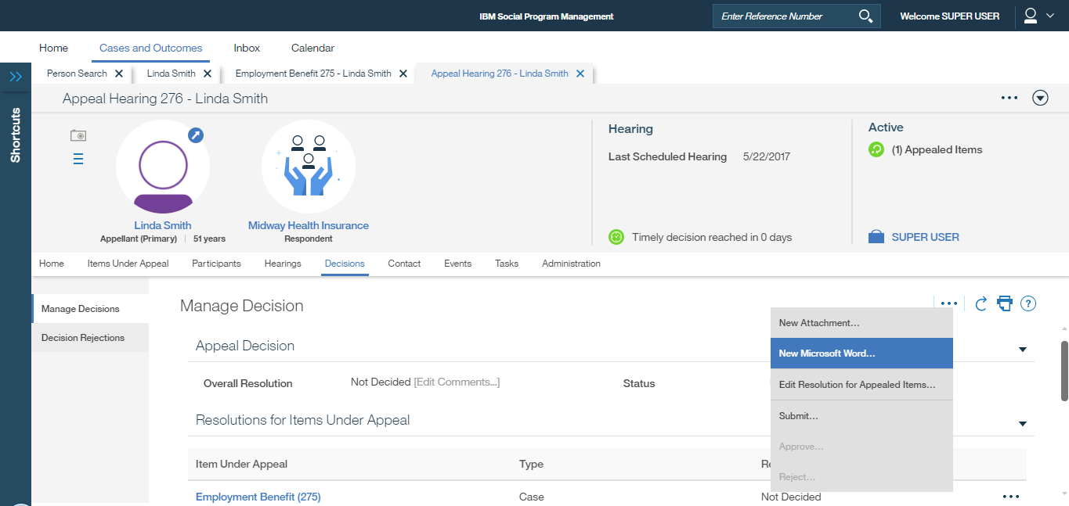
Use Case 2: Appeal Hearing Decision, New Microsoft Word Communication
Appeal Hearing -> Decisions -> Manage Decisions -> New Microsoft Word…

Slide 17
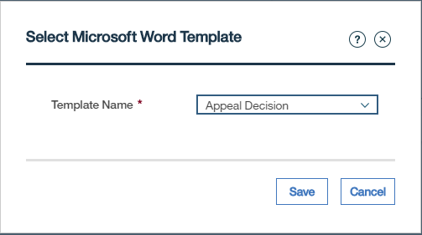
Select Microsoft Word Template Modal
Note selection of Template meets requirement 152268
Save ->

Slide 18
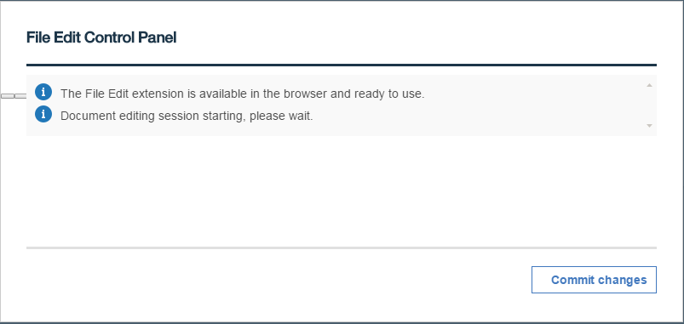
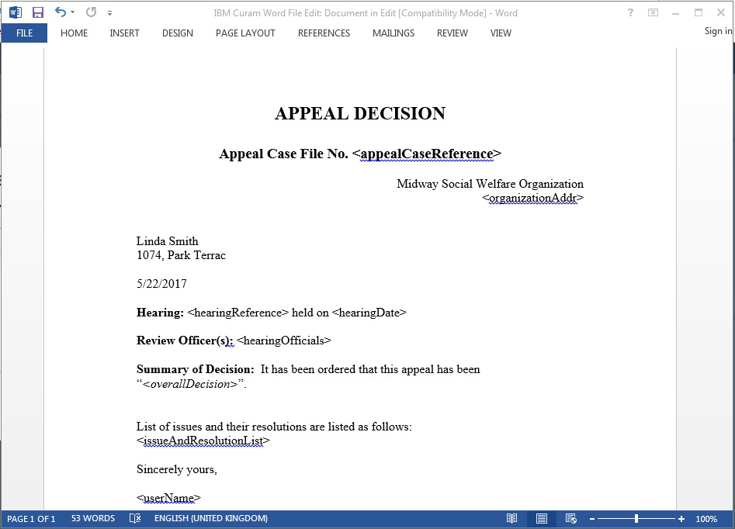
File Edit Control Panel and MS Word Open

Slide 19
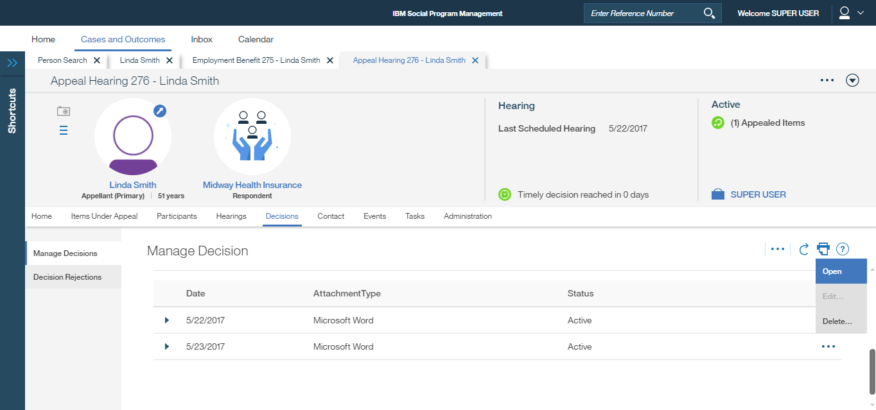
Edit and Close Word => Recorded in Communications List
View, Edit and Delete options available

Slide 20
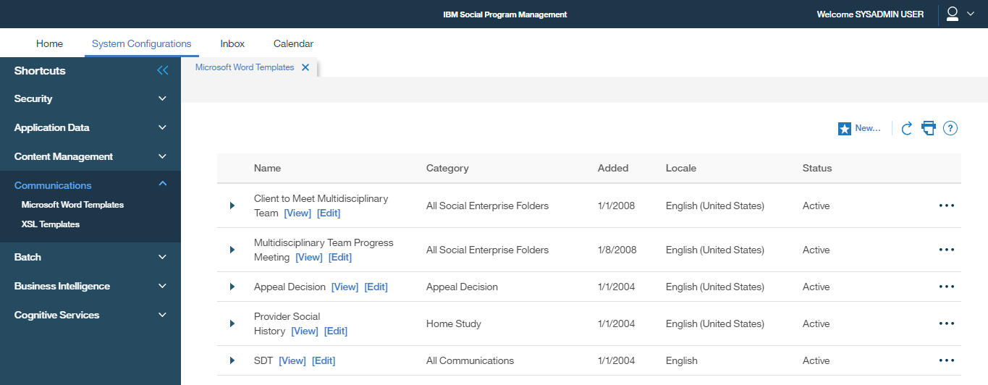
Use Case 3: Sysadmin, MS Word Template Management
Sysadmin login -> System Configurations -> Shortcuts -> Communications -> Microsoft Word Templates -> New…

Slide 21
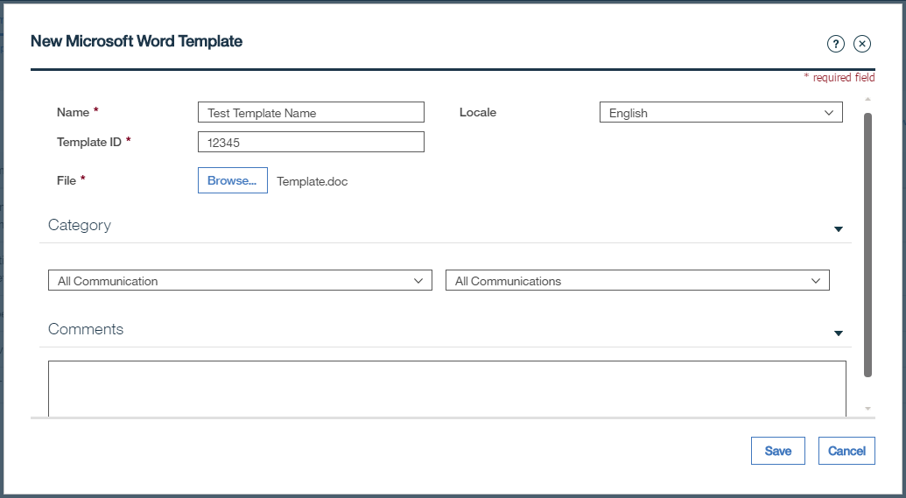
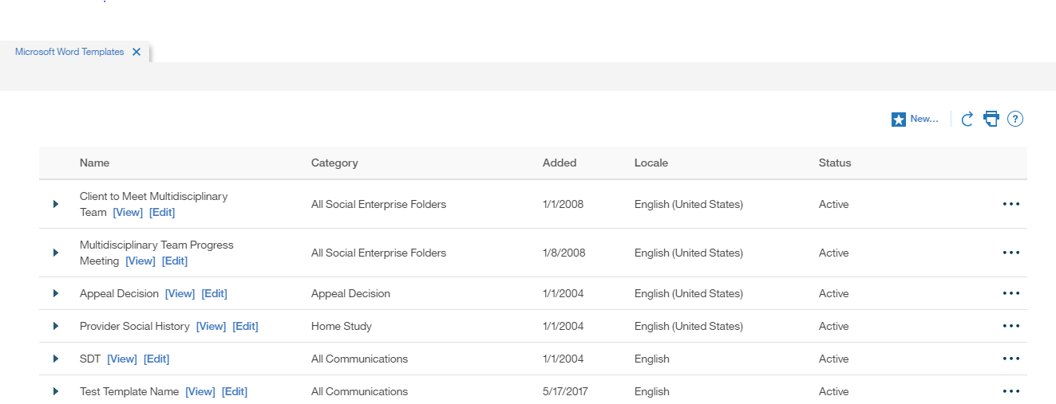
New Microsoft Word Template Modal
Save ->
New entry created in Microsoft Word Templates List

Slide 22
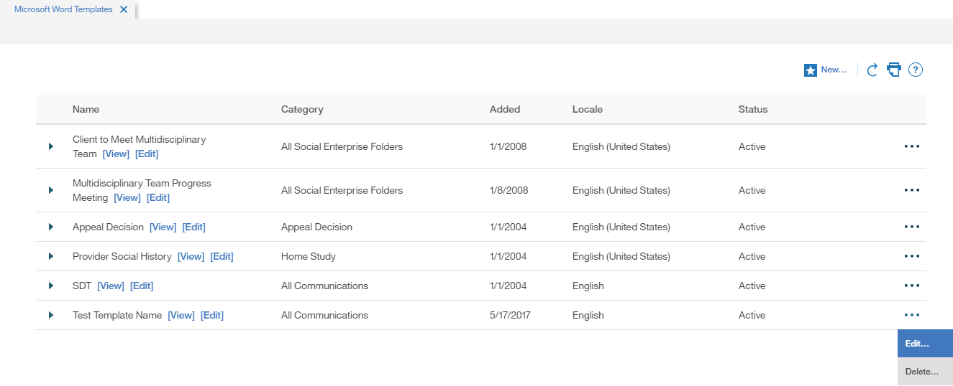
Microsoft Word Template can be Viewed, Edited and Deleted…

Slide 23
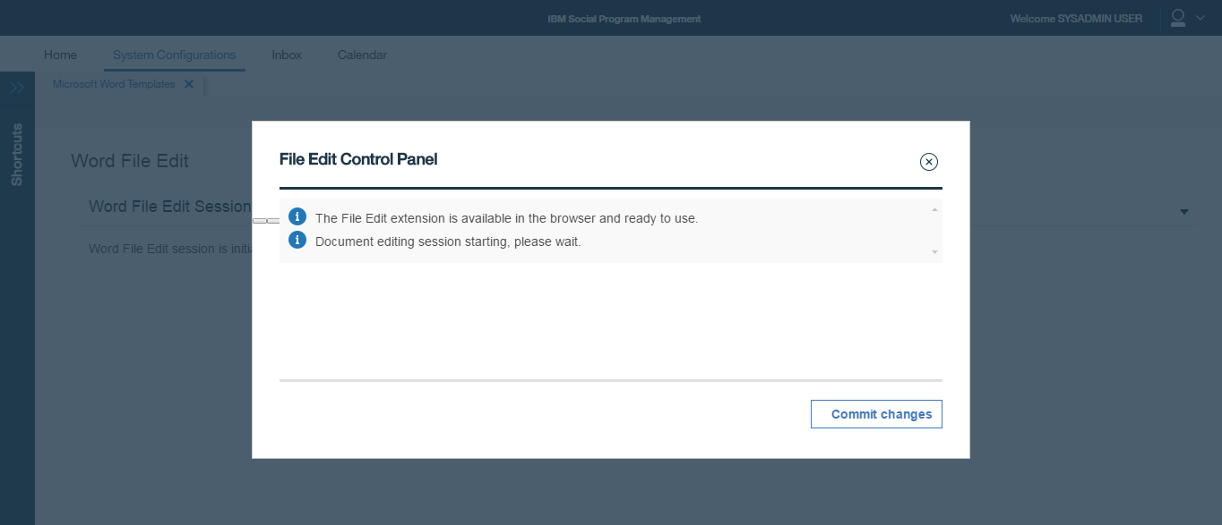
Select [Edit] -> Word File Edit Session is initializing… (Note this step does not work here in Chrome but does work in IE11, see slide 33 below)
Continue ->
… But no Word document opens, Defect?
Note this leaves the IBM Curam Word Integration Assistant on the taskbar and it is not possible to launch Word anywhere else again! Can only clear by logging out?

Slide 24
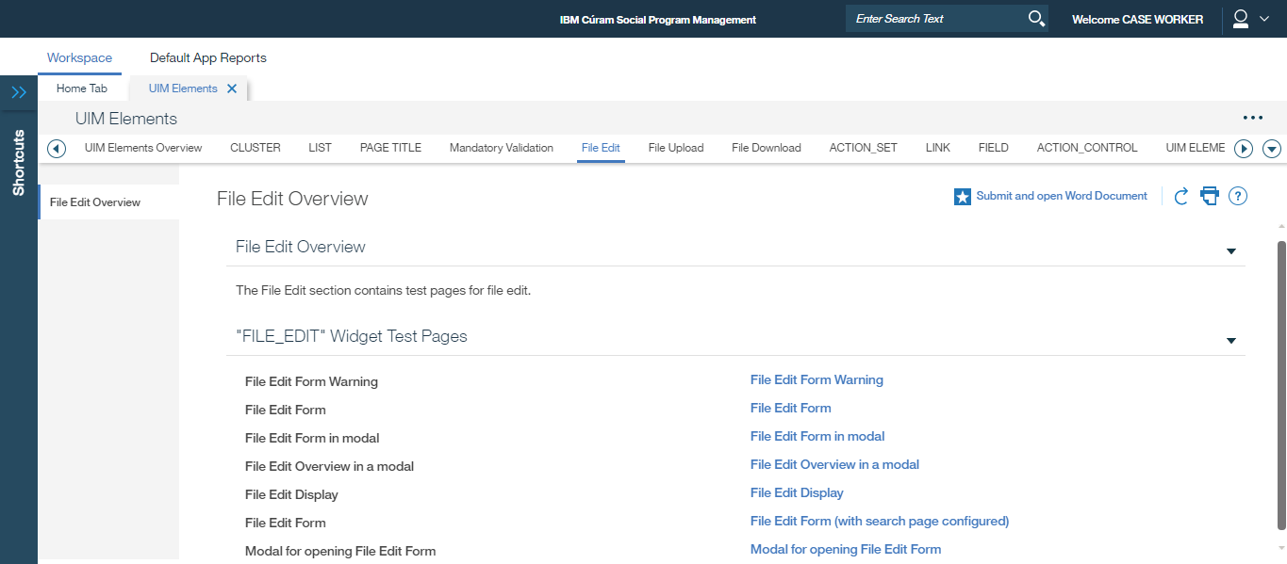
152275: As an Appeals user, I need to be able to search for pre-configured text that I can insert into a new MS Word template
Best server with Appeals module loaded is ‘dslvm1053’. Apparently this functionality is not enabled by default, requires development effort to do so.
Use the TabTest server dubxpcvm3536.mul.ie.ibm.com:
Workspace -> Page with all base data types -> File Edit -> File Edit Form (with search page configured)

Slide 25
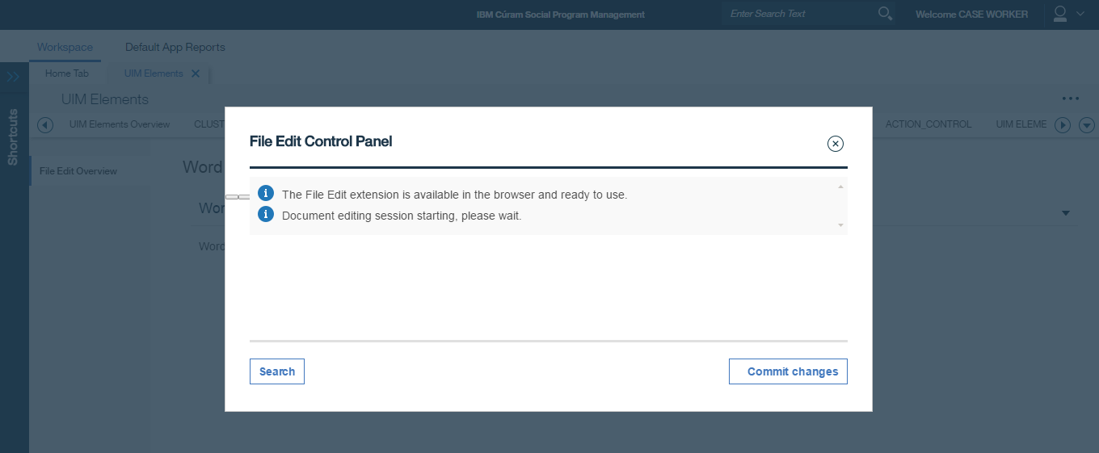
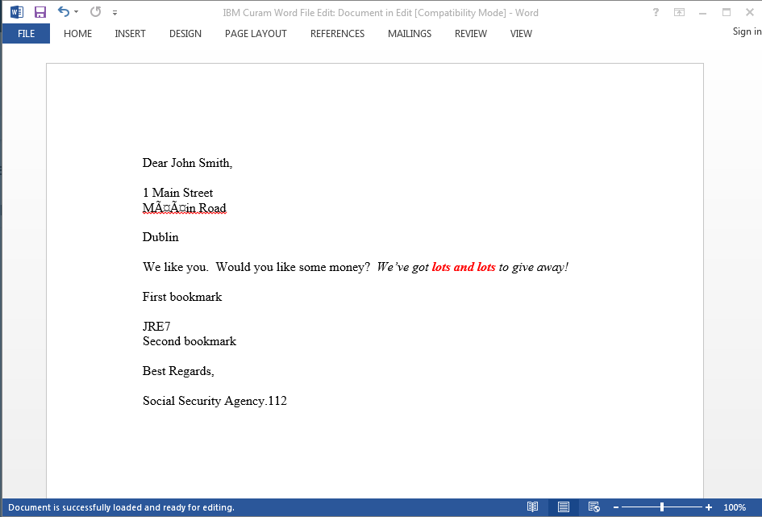
File Edit Control Panel and MS Word Open
This search button launches a modal where you can search and select the appeals clauses (currently only searches on Surname…) More details later in IE11 section.

Slide 26
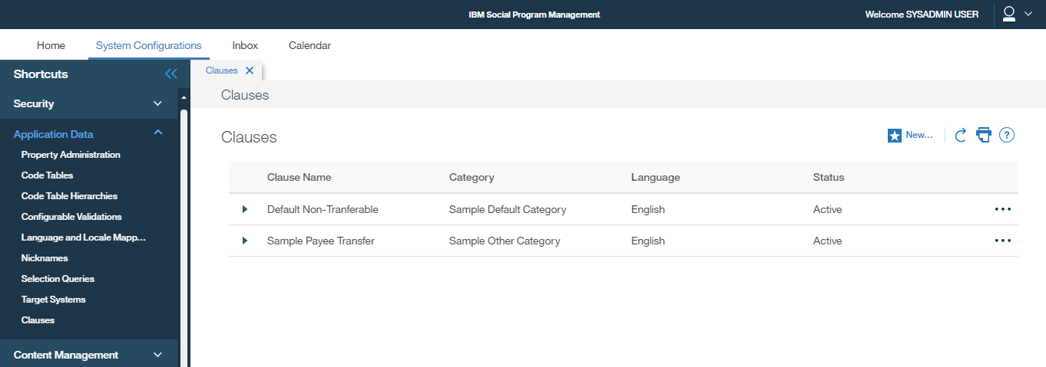
152276: As an Administrator, I need to be able to create standard paragraph text (clauses) that can be used to insert into an MS Word template
Sysadmin login -> System Configurations -> Application Data -> Clauses -> New…

Slide 27
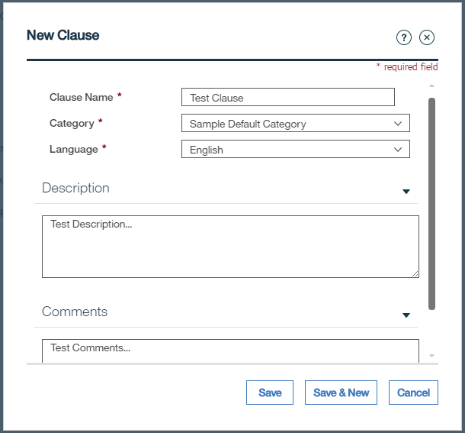
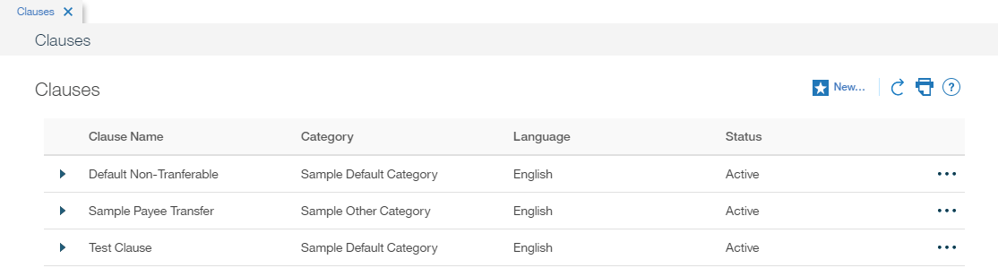
New Clause Modal
Save ->
New entry created in Clause List

Slide 28
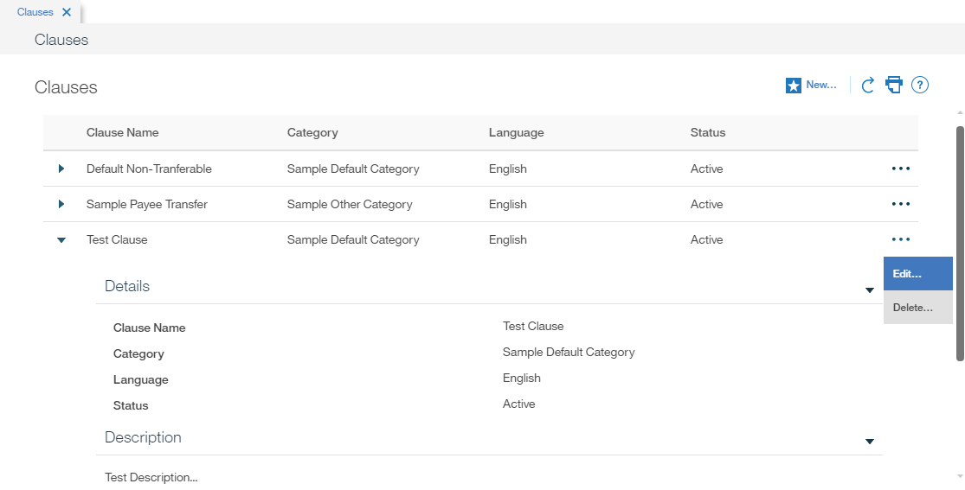
Clause can be Viewed, Edited and Deleted…

Slide 29
152269: As a caseworker, I need to be able to open, view and edit MS Word communications from Cúram Communications pages
How Business Requirements satisfied today, 7.0.1 screenshots, IE11 Browser differences
152268: As a caseworker, I need the option to select an MS Word Document based on a template that I can edit
Use Case 1: Person, New Microsoft Word Communication
Person Page -> Client Contact -> Communication -> New Microsoft Word…

Slide 30
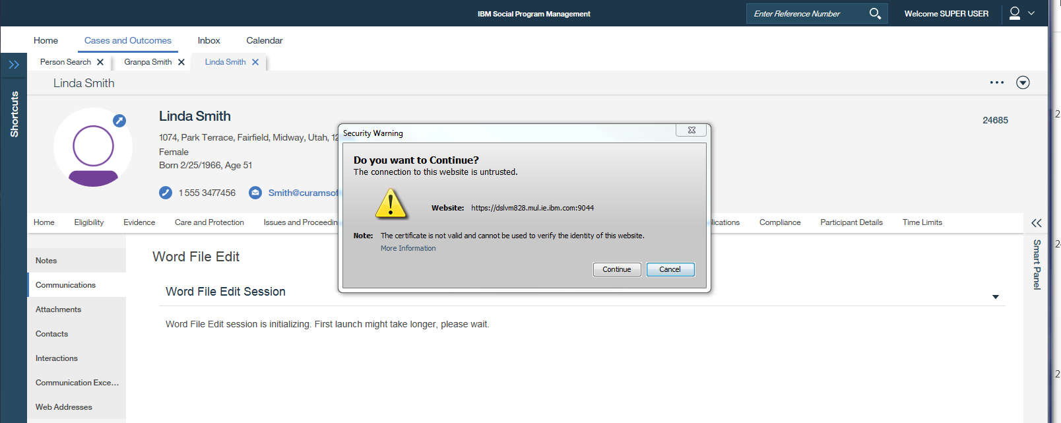
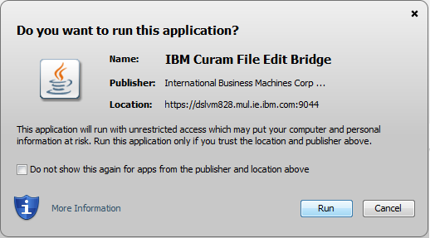

Word File Edit Session is initializing…
Continue ->
IBM Curam File Edit Bridge -> Run ->
JACOB : Java COM Bridge -> Run ->

Slide 31
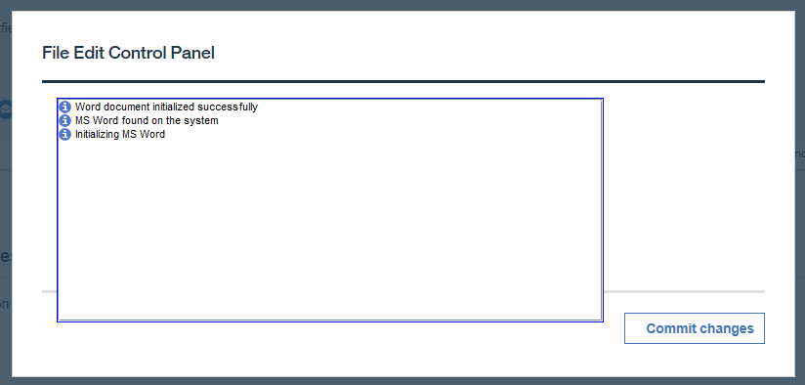
File Edit Control Panel and MS Word Open (Note notification panel larger than modal design)

Slide 32
Use Case 3: Sysadmin, MS Word Template Management
Sysadmin login -> System Configurations -> Shortcuts -> Communications -> Microsoft Word Templates -> New…

Slide 33
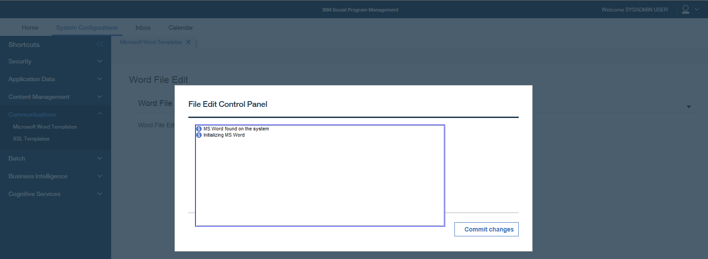
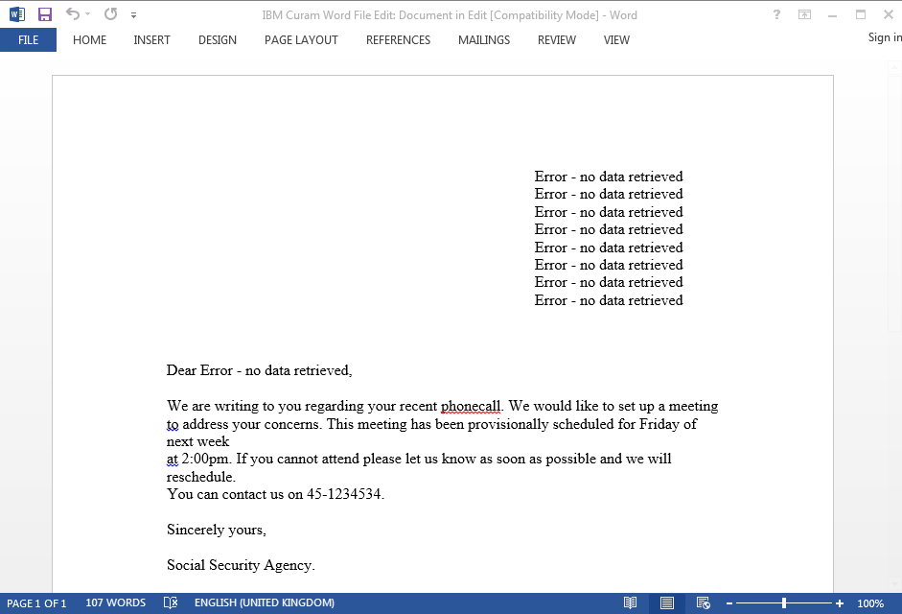
Select [Edit] -> File Edit Control Panel and MS Word Open (Note this step works in IE11 but did not work in Chrome)

Slide 34
152275: As an Appeals user, I need to be able to search for pre-configured text that I can insert into a new MS Word template
Best server with Appeals module loaded is ‘dslvm1053’. Apparently this functionality is not enabled by default, requires development effort to do so.
Use the Tabtest server dubxpcvm3536.mul.ie.ibm.com:
Workspace -> Page with all base data types -> File Edit -> File Edit Form (with search page configured)

Slide 35
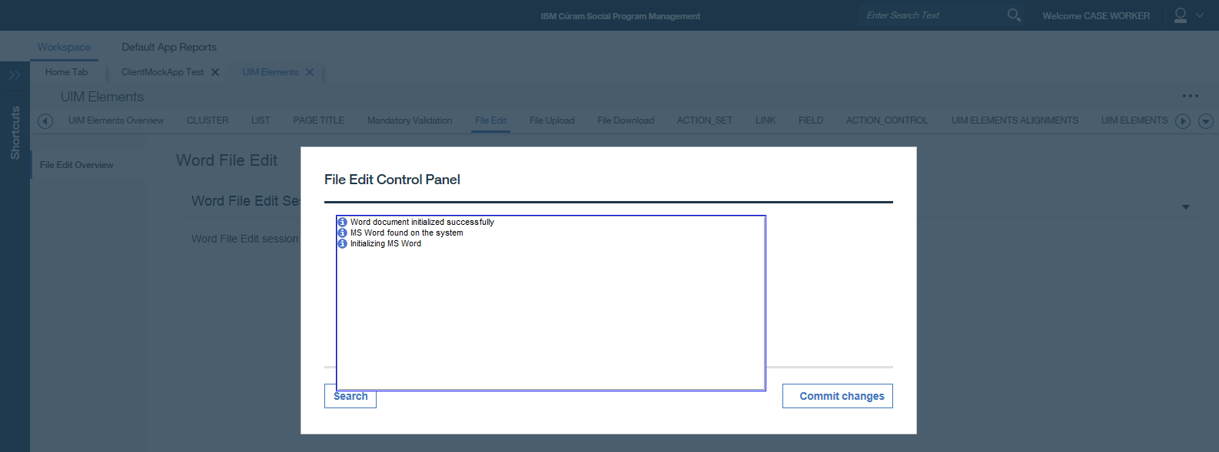
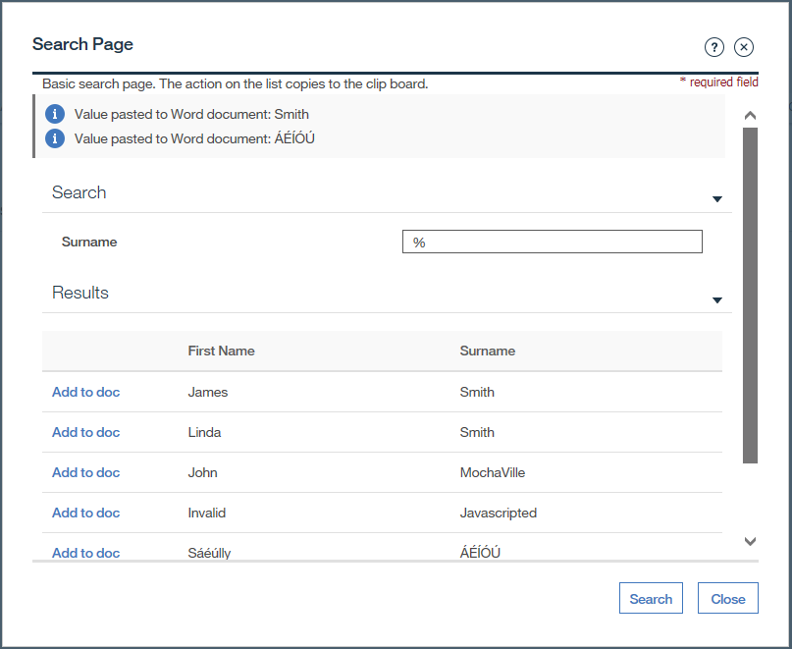
File Edit Control Panel and MS Word Open
This search button launches a modal where you can search and select the appeals clauses (currently only searches on Surname…)
Where are values pasted?

Slide 36
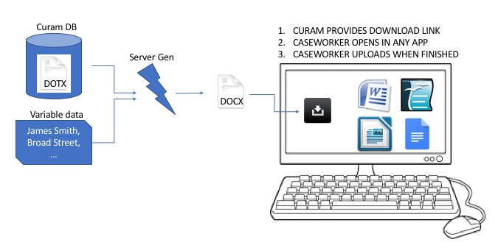
152269: As a caseworker, I need to be able to open, view and edit MS Word communications from Cúram Communications pages
How Business Requirements satisfied in future
152268: As a caseworker, I need the option to select an MS Word Document based on a template that I can edit

Slide 37
Use Case 1: Person, New Microsoft Word Communication
Person Page -> Client Contact -> Communication -> New Microsoft Word…

Slide 38
New Microsoft Word Communication Modals
Next ->
Note selection of Template meets requirement 152268
Save ->

Slide 39
Saved to DB and recorded in Communication list

Slide 40



Edit, Upload New Version, Download, Delete
Row action menu options:
Edit…
Upload New Version Download
Delete

Slide 41
Edit
No longer required
Edit details -> Save -> Closes Modal and goes back to Communications List. Check if edited details such as Address need to be updated both in DB and Word doc?

Slide 42
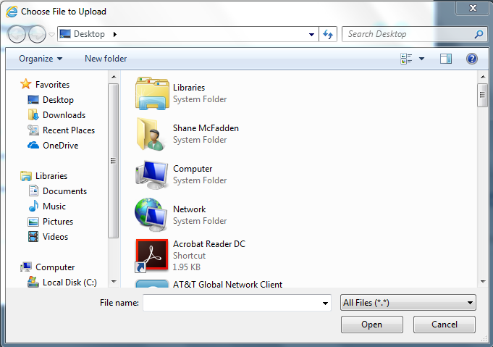
Upload New Version
Use standard File Upload dialog to navigate to and upload the Word document

Slide 43
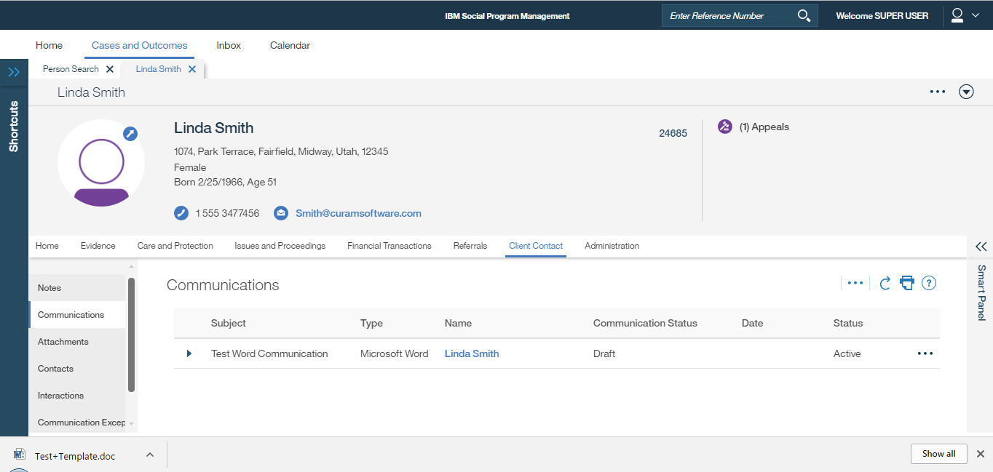
Download
Standard Chrome Download notification on Windows

Slide 44
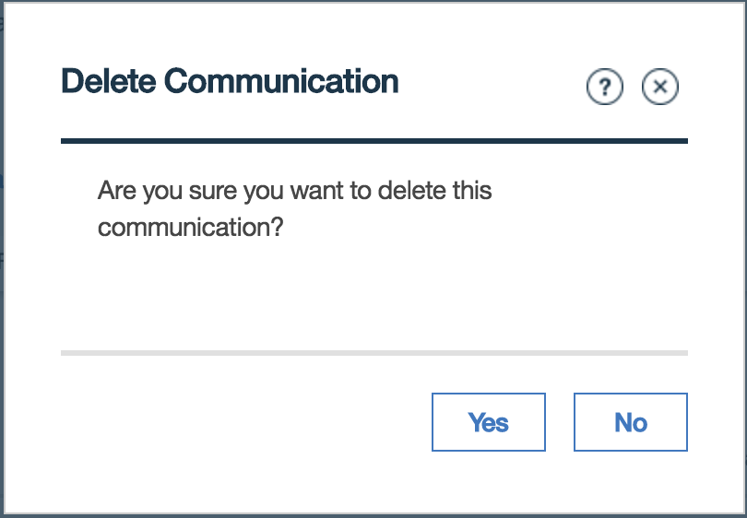
Delete

